Slide 1


23CSP701 : Project Phase – I
Zeroth Review
EduSphere: AI-Powered Student Lifecycle Management Ecosystem
Presented By
SIVAANI S K 727623BCS019
KABIL K 727623BCS133
FAIZAN GAFOOR A 727623BCS191
Faculty Supervisor
Dr. N. Suba Rani ASP/CSE

Slide 2
Contents
Introduction
Literature Survey
Problem statement
Objective of the Project
Novelty of the work
Proposed work
Methodology
Committed Outcome
References

Slide 3
Introduction
EduSphere is an AI-powered academic and career support platform that combines attendance tracking, assignments, coding practice, projects, skills, resume analysis, MCQs, course activity, communication, study time, and login behavior into one intelligent ecosystem.
The platform uses learning analytics and intelligent tutoring concepts to understand student behavior, identify weak areas, and provide personalized recommendations for academic improvement, placement readiness, and career guidance.
The core idea is to build a unified system that not only monitors performance but also predicts risks and supports students through adaptive guidance and smart interventions.

Slide 4
Literature Survey
Recent IEEE work shows that intelligent tutoring systems are becoming more effective when they combine learner modeling, adaptive assessment, and multi-source academic data.
Learning analytics research also emphasizes the importance of tracking progression, engagement, and performance patterns to support timely academic decisions and student success.
In e-learning systems, personalization, quiz support, and feedback-driven interaction are repeatedly identified as major factors that improve learner experience and completion outcomes.

Slide 5
Literature Survey
Feature / Parameter | Base Document 1 | Base Document 2 | Base Document 3 | Base Document 4 | Observed Gap / Limitation | Proposed Modification / Improvement
Title of Paper | Towards a Learning Analytics Support for Intelligent Tutoring Systems on MOOC Platforms | Minimal Invasive Integration of Learning Analytics Services in Intelligent Tutoring Systems | Empowering Student Learning in Intelligent Tutoring Systems: Building a Comprehensive Learner Model With Feedback From Students, Parents, and Instructors | Enhancing learners' experience in e-learning based scenarios using Intelligent tutoring systems and learning analytics: First results from a perception survey | Existing works focus on specific subsystems, not a full academic-career ecosystem | Integrate analytics, tutoring, prediction, placement readiness, and recommendations in one EduSphere platform
Idea of the paper​ | Supports intelligent learning platforms using analytics on student progression and platform behavior | Adds learning analytics services to systems with predictive support for learning problems | Builds learner models using multiple assessment sources for personalized tutoring | Improves e-learning experience using ITS-based evaluation and feedback mechanisms | Most papers emphasize either analytics or tutoring, but not campus-wide personalization | Combine learner model, activity analytics, AI tutor, and predictive engines into a single AI core
Inferences Observed | Student progress data can guide timely academic intervention | Predictive analytics can improve academic support services | Multi-source learner modeling improves personalization quality | Interactive feedback improves engagement and learning flow | Lack of integration with resume, placement, productivity, and collaboration modules | Extend the model to include placement prediction, skill gap analysis, study planning, and digital twin guidance

Slide 6
Problem statement
Current student platforms are mostly fragmented, where attendance, assignments, coding practice, assessments, career preparation, and mentoring are handled through separate tools.
Because of this fragmentation, institutions often fail to generate unified insights about student learning behavior, academic risk, skill development, and placement readiness.
There is a need for a centralized AI-based platform that continuously analyzes student activity and provides personalized academic, learning, and career support.

Slide 7
Objective of the Project
To design and develop EduSphere as an integrated student intelligence platform combining academic, career, collaboration, and analytics modules.
To track academic indicators such as attendance, assignments, quizzes, coding activity, study time, and login behavior for continuous monitoring.
To apply learning analytics for identifying weak areas, engagement patterns, and at-risk students.
To provide personalized tutoring, recommendations, and learning support using intelligent learner modeling.
To improve placement readiness through resume analysis, skill analysis, and career guidance.

Slide 8
Novelty of the work
Existing Student Platforms | EduSphere Innovation
Learning, coding, placement, and collaboration exist as separate applications. | Unified AI-Powered Student Lifecycle Ecosystem integrating all academic and career activities.
Dashboards only display historical data. | AI Digital Twin continuously analyzes student behaviours and builds a dynamic academic profile.
Generic learning resources for all students. | Personalized AI Learning Assistant recommends study plans, notes, quizzes, and coding practice.
Faculty manually monitor student performance. | Machine Learning Risk Prediction automatically identifies at-risk students and sends alerts.
Placement support is limited to resume submission. | AI Career Navigator with ATS resume analysis, skill-gap detection, internship recommendations, and placement readiness scoring.
No prediction of future academic outcomes. | Future Simulation Engine predicts GPA, placement probability, and career growth based on different learning scenarios.

Slide 9
Proposed work
The proposed system collects multi-dimensional student data such as attendance, assignment completion, coding performance, MCQ results, study planner usage, communication activity, certificates, and login behavior.
This data is processed by the EduSphere AI Core to generate performance predictions, recommendations, learning paths, placement readiness analysis, and personalized interventions. The platform also includes an AI tutor, resume builder, ATS analyzer, mock interview support, internship portal, and academic dashboard so that both learning and career growth are supported within the same environment.

Slide 10
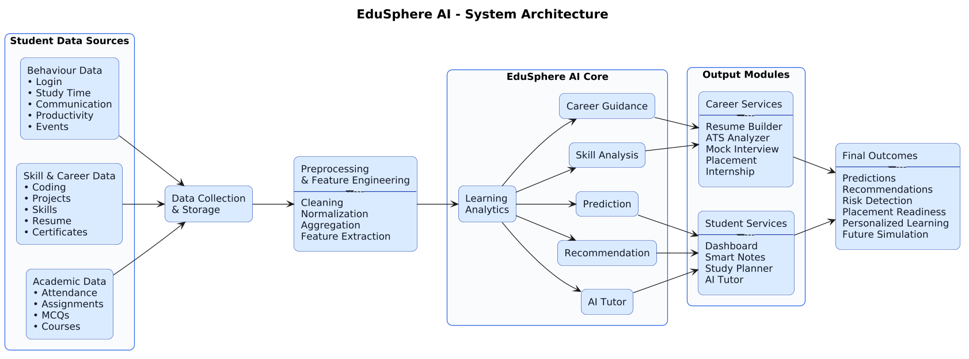
Methodology : Block Diagram

Slide 11
Methodology - Tools / technologies to be used
Frontend: React.js, TypeScript, Tailwind CSS.
Backend: Node.js, Express.js.
Database: MongoDB, Redis.
AI / ML Libraries and Frameworks: Python, scikit-learn, pandas, NumPy, TensorFlow or PyTorch.
NLP / AI Assistant: LLM-based assistant, RAG pipeline for notes, documents, and research support.
Authentication / Security: JWT, OAuth, RBAC.
Cloud / Deployment: AWS or Azure, Docker, GitHub Actions.
Analytics / Visualization: Power BI or custom dashboard charts, Plotly / Chart.js.
Collaboration / Integration: GitHub API, calendar APIs, notification services.

Slide 12
Methodology : Datasets / Experimental Setup
Institutional dataset: attendance records, internal marks, assignment scores, quiz results, coding scores, and semester performance.
Behavioral dataset: study time, login frequency, resource usage, task completion patterns, and interaction logs.
Career dataset: resume fields, skills, certifications, internship interests, and placement history.
Experimental setup:
Collect student activity data from platform modules.
Preprocess and convert data into measurable features.
Train models for performance prediction, risk detection, and placement readiness.
Generate personalized recommendations and compare outcomes.
Evaluate using accuracy, precision, recall, F1-score, and user feedback.

Slide 13
Committed Outcome
Category | Project Research Outcome (any one)
Indexed International Conference | ✓
Indexed Book chapter | -
Indexed Journal publication | -
Patent Filing | -
Patent Grant | -

Slide 14
REFERENCES
A. Abu-Issa et al., “Empowering Student Learning in Intelligent Tutoring Systems,” IEEE, 2025.
R. M. M. F. Luis et al., “Enhancing learners’ experience in e-learning based Intelligent Tutoring System,” IEEE, 2017.
D. Bañeres et al., “Towards a Learning Analytics Support for Intelligent Tutoring Systems,” IEEE, 2016.
C. Schatten et al., “Minimal Invasive Integration of Learning Analytics Services in Intelligent Tutoring Systems,” IEEE, 2014.

Slide 15

Thank You

